Slide 1


DataBase Logic in Business Applications
Al.I. Cuza University of Iași
Faculty of Economics and Business Administration
Department of Accounting, Information Systems
and Statistics
Oracle PL/SQL.
Packages
By Marin Fotache & Co.

Slide 2
Agenda
Definition and utility of PL/SQL packages
Syntax
Package specification
Package body
Function/procedures overloading
Recursivity (2)
Examples of using packages
Information about stored procedures in the data dictionary
Case study: Enrollment at master programmes

Slide 3
PL/SQL Packages...
A sort of containers
May contain:
Public (user-defined) data types
Public cursors
Public exceptions
Procedures
Functions
Two parts
Specifications (compulsory)
Body (optional)

Slide 4
Advantages of Packages
DB apps/modules may have (sometimes) hundreds of variables, exceptions, cursors, functions, procedures; packages gather all these types of objects in a single place, so database schema is clean and easy to maintain
Package definition and package body are stored separatedly in DB dictionary
package definition is public
package body is private (hidden, incapsulated)
Allows DB server to load into memory more objects simultaneoulsy (at first call of the package, the package objects are loaded in memory)
Through packages, Oracle provides public variables in DB apps (which is quite rare in DB servers world)
Support for functions/procedures overloading

Slide 5
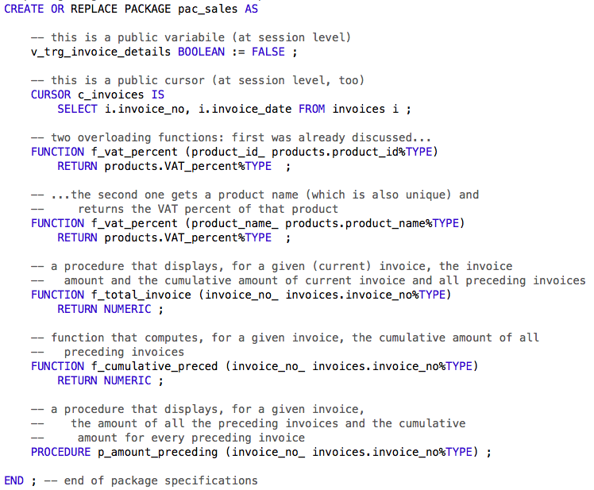
Package specification

Slide 6
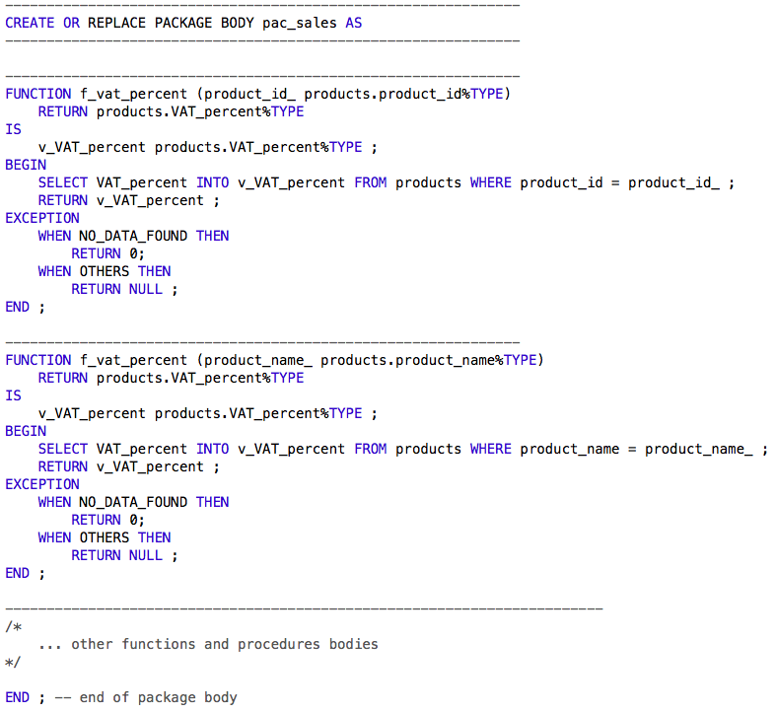
Package body (excerpt)

Slide 7
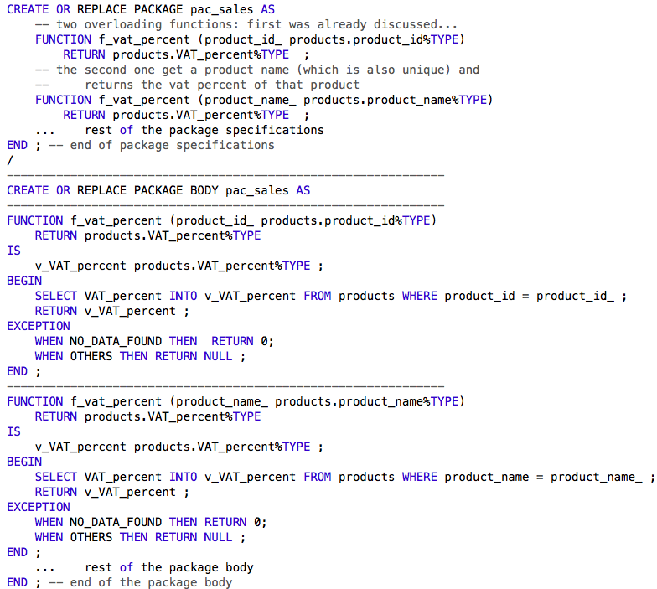
Overloading example

Slide 8
Limits of the packages
Cannot be called globally, but only their objects (variables, cursors, exceptions, functions, procedures)
A_package.a_variable := TRUE ;
Another_variable :=
a_package.a_functions (a_parameter) ;
Cannot be nested
If a function or procedure within the package is invalid, all the package becomes invalid (and consequently unusable)
When package functions and/or procedures are lengthy, the package is difficult to read, test, and debug

Slide 9
Information about stored procedures in the data dictionary
Views of interest in the data dictionary
USER_OBJECTS
USER_OBJECT_SIZE
USER_PROCEDURES
USER_STORED_SETTINGS
USER_ARGUMENTS
USER_SOURCE
USER_ERRORS
USER_DEPENDENCIES
USER_IDENTIFIERS
USER_TRIGGERS and USER_TRIGGER_COLS

Slide 10
Useful Resources
Oracle2003_Cap09_PL_SQL2.pdf (Romanian) – uploaded on FEAA portal
PL/SQL Tutorial (TutorialsPoint) – .pdf file – pp.92-95 - uploaded on FEAA portal
Oracle2003_Cap09_PL_SQL2.pdf (Romanian) – uploaded on FEAA portal
fiola28_BalanteContabile_august2002.pdf (Romanian) – uploaded on FEAA portal
Proceduri stocate şi recursivitate în PLSQL_NetReport_dec2002.pdf (Romanian) – uploaded on FEAA portal (for recursivity – 2)

Slide 11
Useful Resources (cont.)
PL/SQL Tutorial (TutorialsPoint)
http://www.tutorialspoint.com/plsql/index.htm
pl/sql tutorial
http://plsql-tutorial.com
PL/SQL Tutorial
http://www.plsqltutorial.com
Steven Feuerstein - Wrap Your Code in a Neat Package, Oracle Magazine, January/February 2013, http://www.oracle.com/technetwork/issue-archive/2013/13-jan/o13plsql-1872456.html
Steven Feuerstein - The Data Dictionary: Make Views Work for You, Oracle Magazine, November/December 2012, http://www.oracle.com/technetwork/issue-archive/2012/12-nov/o62plsql-1851968.htmll

Slide 12
Video-tutorials
An older video-tutorial (in Romanian): 05_PL SQL – Pachete.mp4
https://1drv.ms/v/s!AgPvmBEDzTOSwlwA6IclMmi63jzq
Oracle PLSQL Training | How to Create an Oracle PL-SQL Package Specification | Video Tutorial
https://www.youtube.com/watch?v=08bc7aI0ebw&list=PLedfdcv1ztFkKCn3fCFK_MrgzHOAcjy9v&spfreload=10
Package In PLSQL
https://www.youtube.com/watch?v=P7CGBEALDZQ&list=PLedfdcv1ztFkKCn3fCFK_MrgzHOAcjy9v&index=2&spfreload=10

Slide 13
Video-tutorials (cont.)
See also the following video-tutorials in the playlist:
https://www.youtube.com/playlist?list=PL3245012E0631F7AE&spfreload=10
PLS-24: PL/SQL Package Introduction
PLS-25: Visibility Rules in PL/SQL Packages
PLS-26: Stored Program Overloading in PL/SQL

Slide 14
Text (in Romanian)
https://github.com/marinfotache/Database-Logic-in-Business-Applications/blob/master/Oracle%209i2.%20Ghidul%20dezvoltarii%20aplicatiilor%202003/Cap08_PL_SQL1/Oracle_Cap08_PL_SQL1.pdf
https://github.com/marinfotache/Database-Logic-in-Business-Applications/blob/master/Oracle%209i2.%20Ghidul%20dezvoltarii%20aplicatiilor%202003/Cap09_PL_SQL2/Oracle_Cap09_PL_SQL2.pdf (sections 9.3-9.5)
https://github.com/marinfotache/Baze-de-date-I/blob/master/SQL.%20Dialecte%20DB2-%20Oracle-%20PostgreSQL%20si%20SQL%20Server/SQL2009_Cap16_Functii_si_proceduri_stocate.pdf (section 16.6)

Slide 15
Git Hub Scripts Associated with this Presentation
https://github.com/marinfotache/Database-Logic-in-Business-Applications/tree/master/02_Basics%20of%20PL%20SQL
02_03a...
02_03b...
02_03c...
02_03d...
02_03e1...
02_03e2...

